Slide 1

The Battle of Neighborhood
Final Presentation

Slide 2
Business
The objective of this capstone project is to analyze and select the best locations in New York to open an Italian restaurant. Using Data Science methodology and instruments such as Data Analysis and Visualization, this project aims to provide solutions to answer the business question: Where in the city of New York, should the investors open an Italian restaurant?

Slide 3
Data
Data Required
List of boroughs and neighborhoods of New York.
Latitude and longitude coordinates of those neighborhoods.
Venue data, particularly data related to restaurants.
Sources of Data
Open source dataset of New York - https://cocl.us/new_york_dataset
Geocoder package for latitude and longitude coordinates.
Foursquare API for venue data.

Slide 4
Methodology
Collect the data from https://cocl.us/new_york_dataset .
Clean and process the data into a Dataframe. Using Foursquare, locate all venues and then filter by Japanese restaurants. Ratings, tips, and likes by users will be counted and added to the Dataframe.
Sort the data based on rankings.
Visually assess the data be will be using graphing from Python libraries.

Slide 5
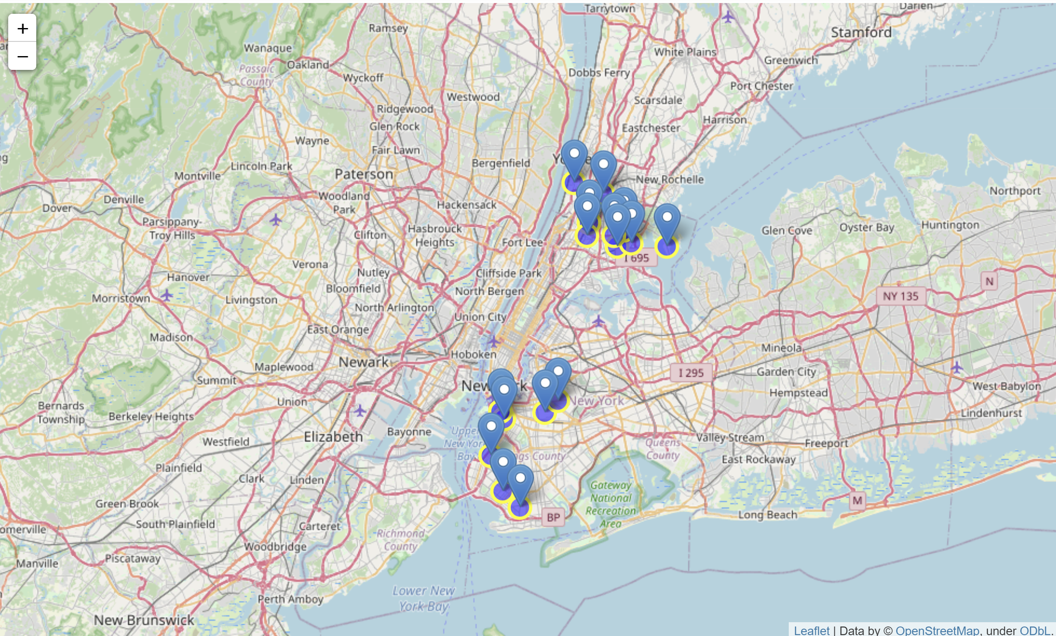
Results
Manhattan has the highest number of Italian restaurants comparing to other boroughs.
Due to the limitations of foursquare, we have only extracted venue details for Bronx and Brooklyn.
Among these boroughs, Brooklyn has the highest average rating for the restaurants.
Bushwick and Bedford Stuyvesant neighborhoods of Brooklyn has the highest rated restaurants.

Slide 6
Discussion Section
Based on the results of our analysis, Brooklyn has the highest rating for Italian restaurants.
Brooklyn is the more promising place to open an Italian restaurant.
Neighborhood Bushwick or Bedford Stuyvesant are the best places in Brooklyn to have Italian Restaurants.

Slide 7
Conclusion
Answer to business question: Where in the city of New York, should the investor open an Italian Restaurant?
Best rated Italian Restaurant in NYC is Carmenta’s Restaurant in Brooklyn.
The findings of this project may be used in real life to better understand the advantages and disadvantages of different New York neighborhoods/boroughs in terms of opening an Italian restaurant.

